Slide 1

Twitter Sentiment
Analysis
NATURAL LANGUAGE PROCESSING
Understanding Brand Perception Through Machine Learning & NLP
Group 1
Muema Stephen • Salma Mwende • Grace Wangui
Machine Learning
Sentiment Classification
Social Media Analytics

Slide 2
Table of Contents
01
Business Problem
02
Project Objectives
03
Dataset Overview
Understanding the challenge of social media monitoring at scale
Defining success metrics and development goals
Exploring 9,093 tweets from SXSW conference
04
Data Understanding
05
Preprocessing Pipeline
06
Feature Engineering
EDA findings and class imbalance analysis
Text cleaning and NLTK-based NLP processing
TF-IDF vectorization and n-gram analysis
07
Model Development
08
Performance Evaluation
09
Key Insights
Iterative approach: Naive Bayes to XGBoost
Comprehensive model comparison matrix
Linguistic patterns and business findings

Slide 3
Business Problem & Context
The Challenge
Business Value
In today's digital marketplace, social media platforms like Twitter serve as primary channels where customers express opinions about products and brands. Companies face critical challenges:
Real-Time Crisis Detection
Identify emerging negative sentiment before it escalates
Automated Monitoring
Volume Overload: Thousands of brand mentions daily make manual analysis impossible
Scale from hundreds to thousands of tweets daily
Smart Prioritization
Response Delays: Traditional monitoring identifies issues only after brand damage occurs
Route critical complaints to specialized response teams
Data-Driven Insights
Resource Constraints: Customer service teams overwhelmed by feedback volume
Measure campaign effectiveness quantitatively
Prioritization Issues: Difficulty distinguishing urgent complaints from general chatter
Success Metrics
Our Solution
We aim to build a model that can accurately classify tweet sentiment with high precision and recall, particularly for negative sentiment where misclassification is most costly from a business perspective.
Build an automated sentiment classification system that processes Twitter data in real-time, categorizing tweets into three sentiment classes:
Positive
Negative
Neutral
Enthusiastic endorsements
Complaints & issues
Informational mentions

Slide 4
Project Objectives & Success Metrics
Main Objective
Develop an end-to-end Natural Language Processing pipeline for automated multi-class sentiment classification that accurately categorizes Twitter data into Positive, Negative, and Neutral sentiment classes, enabling real-time brand monitoring and crisis detection.
Specific Goals
Success Criteria
Handle Class Imbalance
Overall Accuracy
Target: >65%
Implement techniques to address the 61%-33%-6% distribution
Correct classification rate across all sentiments
Robust Negative Detection
Negative Recall
Target: >45%
Maximize recall for negative sentiment (critical for crisis detection)
Percentage of actual negatives correctly identified
Real-Time Processing
Macro F1-Score
Target: >0.55
Enable fast inference suitable for streaming Twitter data
Balanced performance across all sentiment classes
Actionable Insights
Cross-Validation Stability
Low Variance
Provide business-relevant sentiment analysis and recommendations
Consistent performance across different data splits

Slide 5
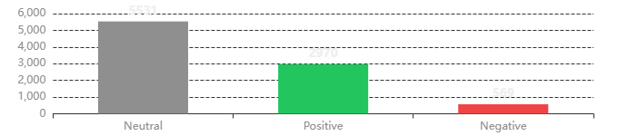
Dataset Overview & Characteristics
Source & Context
Class Distribution
Origin
SXSW Conference Tweets
Challenge: Significant class imbalance requires specialized handling
Total Tweets
9,093 (9,070 after cleaning)
Target Brands
Apple & Google Products
Labeling
Human-Annotated
Data Characteristics
61%
33%
6%
Language: English with social media slang, abbreviations, emojis
Noise: URLs, user mentions (@), hashtags (#), typos
Neutral
Positive
Negative
5,531 tweets
2,970 tweets
569 tweets
Complexity: Sarcasm, context-dependent sentiment
Grammar: Informal, inconsistent punctuation
Implication: The 10:1 ratio between neutral and negative classes creates a significant modeling challenge. Standard accuracy metrics can be misleading—a model that always predicts "neutral" would achieve 61% accuracy while failing completely at crisis detection.

Slide 6
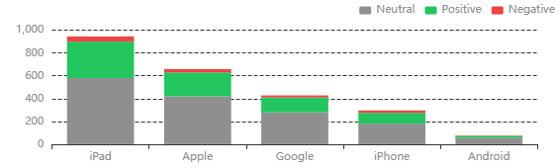
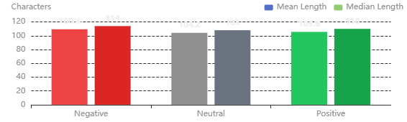
Exploratory Data Analysis Findings
Product Mention Analysis
Key Insights
iPad Dominates Conversation
With 945 mentions, iPad is the most discussed product, followed by Apple (659) and Google (428). Most mentions are neutral, but there's a healthy proportion of positive sentiment.
Negative Tweets Are Longer
Negative tweets average 109 characters vs. 104 for neutral tweets. Complaints require more words to explain issues, while neutral tweets are often brief mentions.
Tweet Length by Sentiment
SXSW Context Matters
The conference setting explains the 61% neutral class—high volume of promotional/informational tweets. Tech-savvy audience shows lower complaint rates typical of brand-loyal users.
Modeling Implication: Tweet length alone won't be a strong predictor—the specific words matter more than how many there are. Product-specific patterns suggest brand-level sentiment analysis could enhance performance.

Slide 7
Text Preprocessing Pipeline
Data cleaning is crucial for NLP. Poor quality data leads to poor model performance, regardless of model sophistication. Our comprehensive preprocessing pipeline transforms messy, unstructured text into clean, analyzable features.
Basic Cleaning
Advanced NLP (NLTK)
URL Removal
Tokenization
Strip http/https links from tweets
Split text into individual words using NLTK word_tokenize
Mention Removal
Lemmatization
Remove @username references
Reduce words to root form using WordNet ("running" → "run")
Hashtag Processing
Stopword Removal
Keep hashtag text, remove # symbol
Eliminate common words while preserving sentiment-bearing negations
Special Characters
Smart Retention
Eliminate punctuation and numbers
Keep critical sentiment words: "not", "no", "but", "against"
Case Normalization
Convert all text to lowercase
Before & After Examples
Original Tweet
After Basic Cleaning
Final Processed
"@apple I LOVE my new iPhone! Check out http://apple.com #awesome"
"i love my new iphone check out awesome"
"love new iphone check awesome"

Slide 8
Feature Engineering: TF-IDF & N-grams
TF-IDF Vectorization
Top Bigrams by Sentiment
Term Frequency-Inverse Document Frequency (TF-IDF) transforms text into numerical features by emphasizing distinctive words over common terms.
Positive Sentiment
apple store
sxsw link
come see
iphone app
popup store
Max Features
N-gram Range
Negative Sentiment
7,000
(1, 2)
design headache
google circle
ipad design
crashy app
Most important terms
Unigrams + Bigrams
Neutral Sentiment
Min Doc Freq
TF Scaling
social network
new social
network called
google launch
2
Sublinear
Eliminates rare words
Logarithmic weighting
Why N-grams Matter
Individual words (unigrams) don't always capture meaning. Phrases like "not good" have the opposite meaning of "good" . Bigrams capture multi-word sentiment expressions that unigrams miss.
Key Finding: Bigram analysis validates that capturing multi-word expressions significantly improves model performance by identifying sentiment-bearing phrases that unigrams miss entirely.

Slide 9
Model Development Strategy
We implemented an iterative approach, starting simple and progressively refining our models. Each iteration builds upon insights from the previous, systematically improving performance.
1
Baseline
2
Enhanced
3
Advanced
4
⭐ SELECTED
5
Ensemble
Naive Bayes
Enhanced NB
Logistic Reg
Linear SVM
XGBoost
Fast baseline with interpretable probability estimates
Added bigrams, increased vocabulary size
Handles feature dependence better than Naive Bayes
Optimal decision boundaries in high-dimensional space
Gradient boosting with tree-based learning
Features
5,000
Features
7,000
Weights
Balanced
Weights
Balanced
Estimators
100
N-grams
(1,1)
N-grams
(1,2)
Regularization
L2 (C=1.0)
Regularization
C=0.5
Learning Rate
0.1
Validation Strategy
Evaluation Metrics
Train-Test Split
Accuracy
Precision
80% training (7,255) / 20% testing (1,814)
Overall correctness
Predicted positives accuracy
Stratification
Preserves original sentiment distribution
Recall
F1-Score
Cross-Validation
Actual positives identified
Precision-recall balance
5-fold CV for robustness assessment

Slide 10
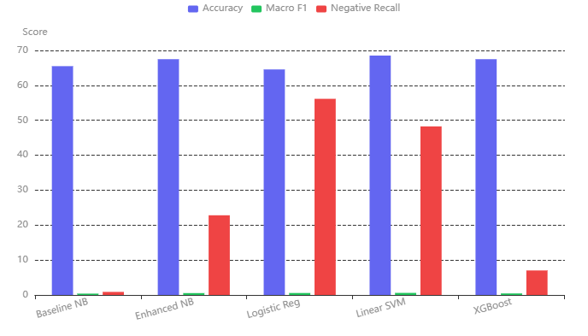
Model Performance Comparison
Comprehensive Model Comparison
Performance Matrix
Model | Acc | Macro F1 | Neg Recall
Linear SVM ⭐ | 68.52% | 0.597 | 48.25%
Enhanced NB | 67.48% | 0.541 | 22.81%
XGBoost | 67.48% | 0.442 | 7.02%
Baseline NB | 65.49% | 0.392 | 0.88%
Logistic Reg | 64.55% | 0.565 | 56.14%
Model Strengths
Linear SVM
Best overall balance, production-ready
Logistic Regression
Highest negative recall (56%)
Enhanced NB
Fast baseline, interpretable
The Accuracy Paradox
While XGBoost shows comparable accuracy (67.48%) to Linear SVM (68.52%), it misses 93% of negative sentiment (7% recall). This demonstrates why accuracy alone is misleading for imbalanced datasets.

Slide 11
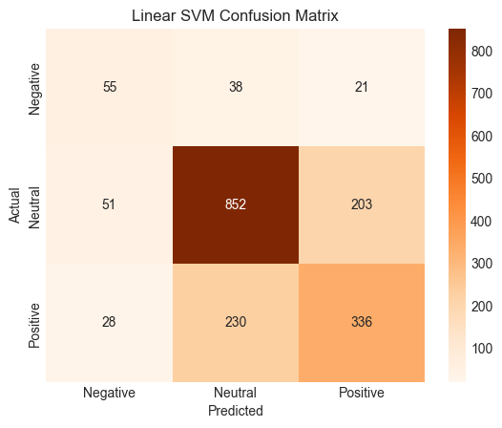
Linear SVM: Production Model Deep Dive
Confusion Matrix
Linear SVM Selected
Best Overall Performance
Overall Accuracy
Macro F1-Score
68.52%
0.597
Correct classification rate
Balanced performance
Negative Recall
Negative F1-Score
48.25%
0.444
Catches nearly half of complaints
Best balance for crisis detection
Why Linear SVM Won
Highest Overall Accuracy
68.52% ensures reliable predictions across all classes
Strong Negative F1-Score
Top Performance: It led with 68.52% accuracy and the highest overall balance. It doesn't just guess; it understands language nuances.
Business Critical: While others ignored complaints, the SVM delivered the highest Negative F1 (0.4435). It catches negative sentiment without constant false alarms.
Proven Stability: 5-fold cross-validation confirmed a Mean F1 of 0.5542 with minimal variance. This model is reliable and ready for deployment.
0.44 balances recall and precision for crisis detection
Cross-Validation Stability
Mean F1: 0.554 ± 0.025 confirms stable generalization
Fewer False Positives
Reduces customer service workload vs. Logistic Regression

Slide 12
Key Insights & Linguistic Patterns
Critical Findings
Linguistic Patterns Discovered
The Accuracy Paradox
Positive Sentiment Indicators
1
XGBoost shows comparable accuracy (67.48%) to Linear SVM (68.52%) but misses 93% of negative sentiment . Accuracy alone is misleading for imbalanced datasets.
love
excited
amazing
check out
awesome
Action verbs and enthusiasm markers dominate positive tweets
Negative Sentiment Indicators
2
Sentiment Distribution Patterns
hope
issue
problem
not working
crash
iPad dominates (945 mentions, predominantly positive). Apple shows strong brand loyalty. iPhone has more polarized sentiment.
Complaint markers and longer tweet length (109 vs 104 chars)
Neutral Sentiment Indicators
3
Cross-Validation Stability
new social
google launch
network called
major new
Linear SVM shows low variance (±0.025) across 5-fold CV, confirming stable generalization to unseen data.
Informational phrases without emotion words, shortest length
Model Trade-offs
Business Implication: Linear SVM achieves the best business balance by maintaining high overall performance while detecting nearly half of all complaints.
Logistic Regression
Linear SVM (Selected)
Strength: Highest negative recall (56%)
Strength: Best overall balance
Weakness: Lower overall accuracy
Weakness: Moderate negative recall

Slide 13
Business Recommendations & Deployment
Immediate Deployment Actions
Crisis Management Protocol
A. Operationalize Crisis Alerts
1
Alert Level Yellow
20% Spike
Set confidence threshold at 0.7 for high-priority alerts. Route negative tweets to specialized response dashboard with 15-minute SLA.
Model detects spike in negative sentiment → Automated alert
2
Alert Level Orange
Confirmed
Human review confirms emerging issue → Escalate to PR team
3
Alert Level Red
Public
Public acknowledgment if trend continues → Full crisis mode
B. Customer Service Integration
Product Launch Monitoring
Smart Routing: Auto-assign to product teams
Priority Queue: Surface high-confidence complaints
Context: Include product, length, confidence score
Pre-Launch
Establish sentiment baseline 2 weeks before
Launch Day
Real-time monitoring with 5-minute refresh
Sentiment Dashboard
Post-Launch
Track sentiment decay over 30 days
Real-Time Pulse
Product Breakdown
Expected Impact: Reduce crisis response time from hours to minutes, prioritize 50+ daily complaints automatically, and enable data-driven brand health monitoring.
Live sentiment gauge
By iPad, iPhone, etc.
Trend Analysis
Top Issues
Hourly/daily shifts
Common bigrams

Slide 14
Future Work & Project Conclusion
Model Improvement Roadmap
Project Success Summary
1
Phase 1: Short-Term (1-3 months)
What We Achieved
Feedback loop with customer service labels
Built end-to-end NLP pipeline for sentiment classification
A/B test confidence thresholds (0.6 vs 0.7 vs 0.8)
Achieved 68.52% accuracy with robust negative detection
Error analysis on 100 misclassified tweets per class
Demonstrated the accuracy paradox in imbalanced datasets
Identified key linguistic patterns for business insights
2
Phase 2: Medium-Term (3-6 months)
Key Takeaways
Emoji sentiment analysis (😊, 😡, 🔥)
Text preprocessing is critical for accurate predictions
Aspect-based sentiment (battery, screen, price)
Model selection significantly impacts business outcomes
SMOTE for class imbalance mitigation
Balanced metrics essential for imbalanced datasets
Cross-validation ensures stable generalization
3
Phase 3: Long-Term (6-12 months)
BERT fine-tuning for 5-10% accuracy gain
Multi-modal analysis (images + videos)
Business Applications
Conversation context (tweet threads)
Monitor Opinion
User Behavior
Data Decisions
Brand Reputation
Group 1

Slide 15
Thank You

